Slide 1
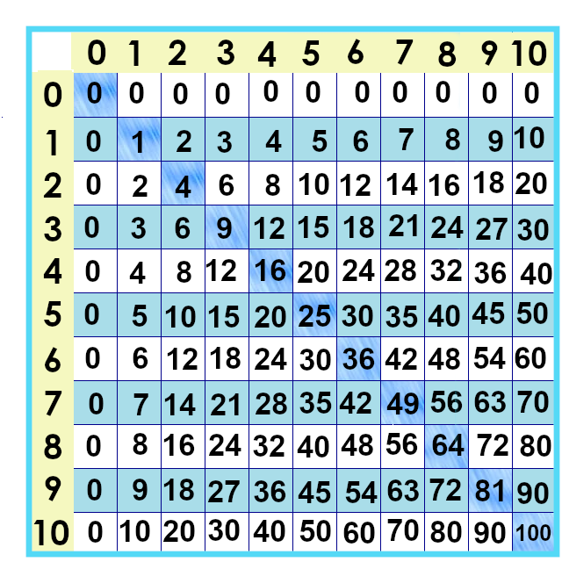
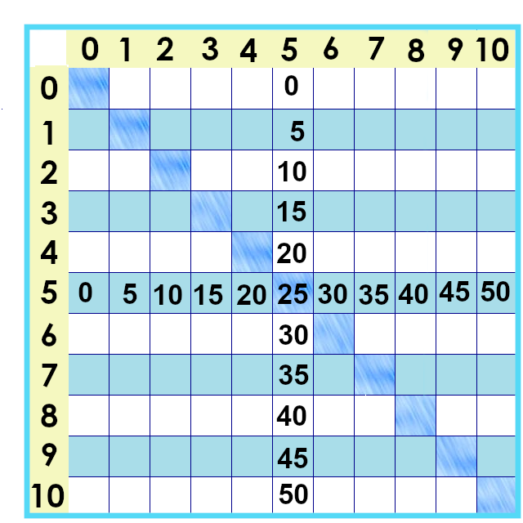
Notes:
The next group of facts we’ll tackle are the fives times tables.

Slide 2
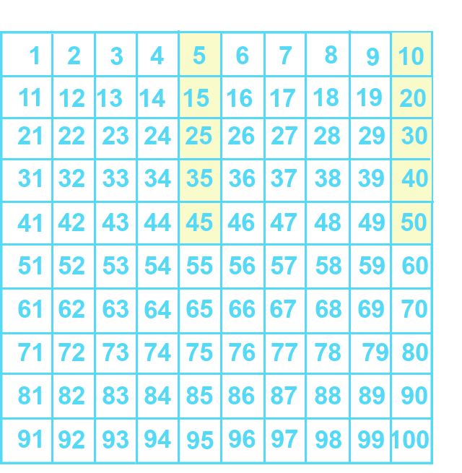
Notes:
Here are what the five facts look like on the numbers chart. Do you notice anything?

Slide 3
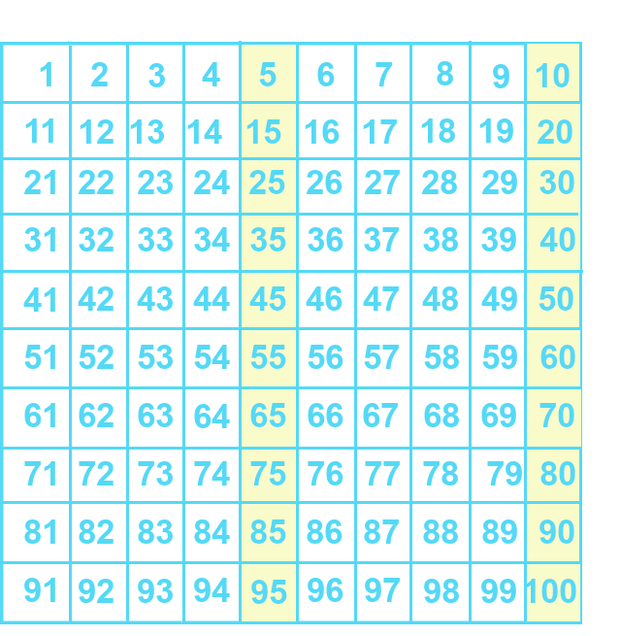
Notes:
Yes, that pattern keeps going on and on forever.
What do you notice about the last digit of these numbers? ... That’s right, they end in 5 or 0, switching back and forth. If a number is divisible by 5, it ends in 5 or 0.

Slide 4
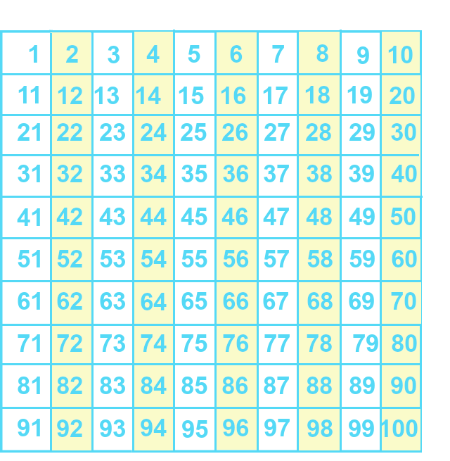
Notes:
Remember the twos? They also lined up nicely on the numbers chart.
Why do you think this is?

Slide 5
Notes:
10 is divisible by both 2 and 5. 10 divided by 5 is 2; 10 divided by 2 is 5.
So, the multiples line up nicely on the tens chart.

Slide 6
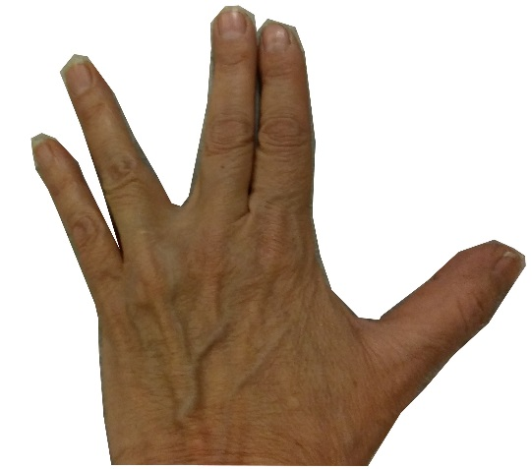
... Old fashioned ways ☺
15
40
10
35
45
20
5
30
50
25
Notes:
We can count by fives on our fingers, too. If you can count by tens then you change it up so you insert that “five” fact half way between.
So... 5 x 3 is ... 5, 10, 15.
5 x 5 is ... 5, 10, 15, 20, 25.

Slide 7
Evens
Odds
0 x 5 = 0
2 x 5 = 10
4 x 5 = 20
6 x 5 = 30
8 x 5 = 40
10 x 5 = 50
1 x 5 = 5
3 x 5 = 15
5 x 5 = 25
7 x 5 = 35
9 x 5 = 45
Notes:
Multiplying by an even number – that’s on the left. Notice anything about them?
Any ideas why? What about the odds?

Slide 8
Evens
Odds
0 x 5 = 0
2 x 5 = 10
4 x 5 = 20
6 x 5 = 30
8 x 5 = 40
10 x 5 = 50
1 x 5 = 5
3 x 5 = 15
5 x 5 = 25
7 x 5 = 35
9 x 5 = 45
Notes:
If you multiply 5 by an even number, it ends in zero.
Why? Because an even number is divisible by2. If it’s also divisible by 5…. Then it’s divisible by ten. 4 x 5 is the same as 2 x 2 x 5
The odds end in 5.

Slide 9
Evens
Odds
0 x 5 = 0
2 x 5 = 10
4 x 5 = 20
2 x 2 x 5 =2 x 10
6 x 5 = 30
8 x 5 = 40
10 x 5 = 50
1 x 5 = 5
3 x 5 = 15
5 x 5 = 25
7 x 5 = 35
9 x 5 = 45
Notes:
Regrouping facts like this is a really powerful way of figuring out problems that look hard. It’s worth spending some time on it.

Slide 10
5 x 5 as short cut to get to 5 x 6 ☺
5 x 6 =
30
5 x 2 x 3 =
30
30
25
Notes:
We can use the distributive property here, too. If we remember 5 x 5 is 25, and we need to get to 5 x 6, we can say 25....30 ... 5 x 6 = 30. We can look at it as “5 x 2” x 3 or 10 x 3, too.

Slide 11
5 x 5 as short cut to get to 5 x 7 ☺
5 x 7 =
35
35
30
25
Notes:
for 5 x 7... 25, 30, 35...

Slide 12
5 x 8 =
40
35
40
30
25
Notes:
for 5 x 8... 25, 30, 35...

Slide 13
5 x 5 as short cut to get to 5 x 9 ☺
5 x 9 =
45
40
35
45
30
25

Slide 14
5 x 10 =
50
50
25
Notes:
And ... Finally... 5 x 10 is 50.

Slide 15
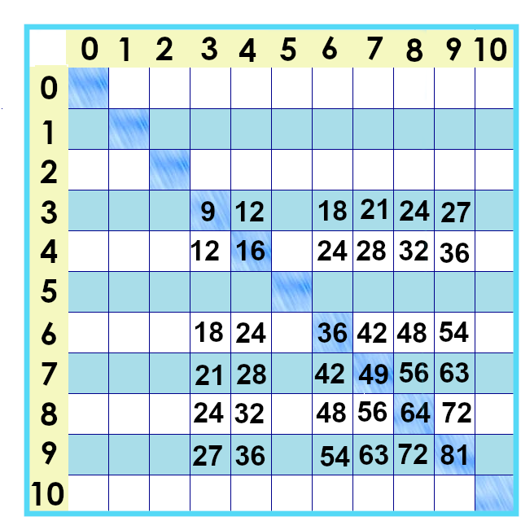
Notes:
Hey, once we’ve practiced these, there aren’t that many facts left to learn, are there? ☺ ☺ Can you fill in the ones you know?

Slide 16
Yes, you can download, share, &/or change this if you:
Please attribute to Susan Jones with a link to http://www.resourceroom.net
This work is licensed under https://creativecommons.org/licenses/by/4.0/
This license lets others modify work even for commercial purposes, as long as credit is given to me. See https://creativecommons.org/licenses/ for more information & links to the license deed and legal code.
My email is sue@resourceroom.net
or sujones@parkland.edu
Notes:
http://www.achieve.org/EQuIP
http://creativecommons.org/tag/k12-oer-collaborative

