Slide 1
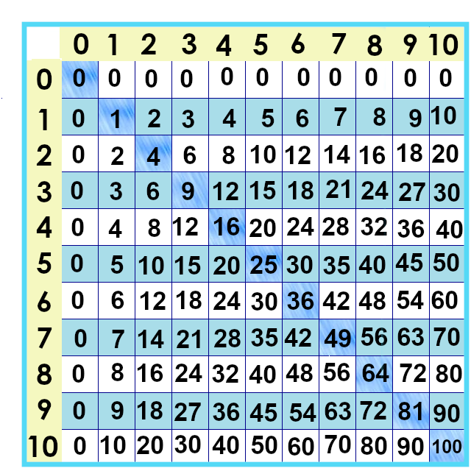
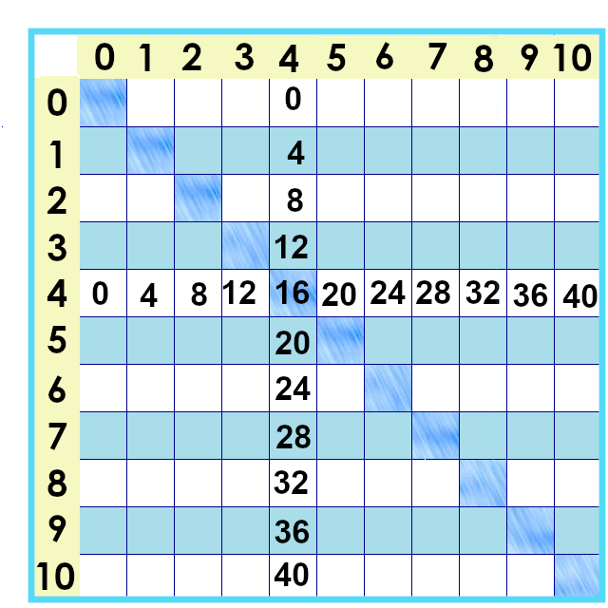
Notes:
This is what the fours look like on the times tables chart.

Slide 2
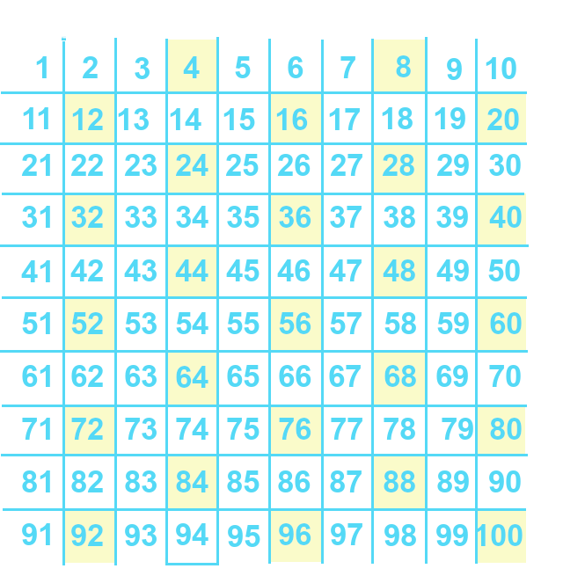
Notes:
This is what the fours look like on the numbers chart.
Do you notice any patterns?

Slide 3
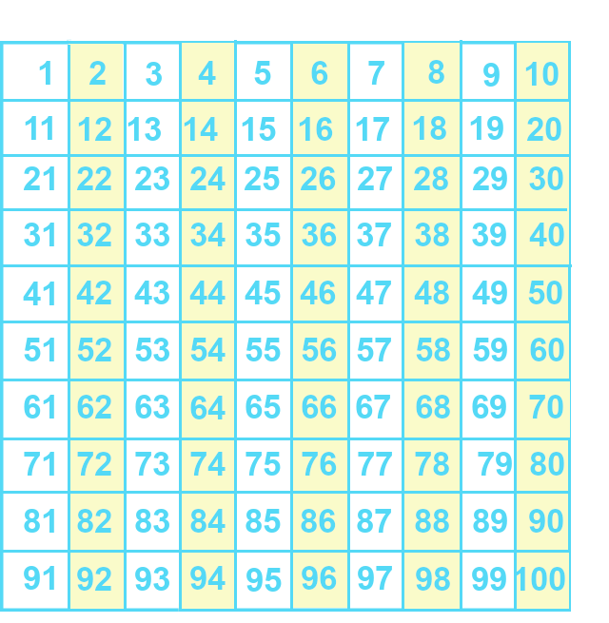
Multiples of Two
Multiples of Four
Notes:
What do you notice about the multiples of two... And the multiples of four?
One thing I see is that all the multiples of four are also multiples of two.

Slide 4
Multiples of Two
Multiples of Four
4 x 1 = 2
4 x 2 = 8
4 x 3 = 12
4 x 4 = 16
4 x 5 = 20
Notes:
Let’s look at some patterns for the facts we want to memorize. These patterns are true for all the multiples of four, but we’ll focus on these.

Slide 5
4 x 1
4 x 1 =4
Notes:
Let’s look for a pattern here, starting with 4 times 1. I double the one... Get two.... I hold that in my mind and ...double it again...4 So, 4 x 1 is four. Of course, I should know that already because 1 times anything is... The same thing..

Slide 6
4 x 1 =4
4 x 2
4 x 2 = 8
Notes:
Okay, keep that in mind.... For Four times two... I double the 2 and get four cute socks. I double those 4 socks and now I’ve got 8 socks. So... 4 x 2 is 8.

Slide 7
4 x 3
4 x 3 =12
Notes:
Let’s keep going. Four times three... I can double 3 to get six... Then double 6 to get 2 4 6 8 10 12...
Think “multiply by four? DOUBLE DOUBLE!”

Slide 8
4 x 3
4 x 3 =12
Notes:
It’s still four groups of three if I arrange them a little different ly ;) That’s thinking mathematically.

Slide 9
4 x 4
4 x 4 = 16
Notes:
Next! Four times four– double the four for eight... Then double it again... 16. Four times four is 16.

Slide 10
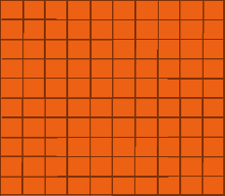
Double 200...
Double again...
4 x 200 = 800
Notes:
Yes.... It goes on forever.

Slide 11
4 x 1 = 4
4 x 2 =
8
Notes:
One more time ....

Slide 12
4 x 3 =
12
4 x 4 =
16
Notes:
4 x 3 .... Double 3 for six.... Double six for 12.... 4 x 3 is... 12
4 x 4... Double 4 for 8.... Double 8 for 16.... 4 x 4 is .... 16

Slide 13
4 x 5 =
20
Notes:
And for the last one for this lesson, 4 x 5... See if you can beat me to it. Hit pause if you need to... Double 5 for ten... Double ten for 20.... 4 x 5 is 20.
And yes, 4 x 5 is the same as 2 x 10. There are lots of ways to get to the right answer!

Slide 14
4 x 0 =
4 x 1=
4 x 2 =
4 x 3 =
4 x 4 =
4 x 5 =
Notes:
Lots of ways to look at it! How many do you remember?

Slide 15
4 x 0 = 0
4 x 1= 4
4 x 2 = 8
4 x 3 = 12
4 x 4 = 16
4 x 5 = 20
Notes:
Here are the answers ☺ Next lesson – the big ones and how to double anything!

Slide 16
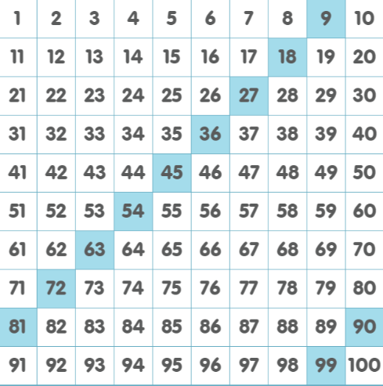
Notes:
,.... Yes, it goes on forever....

Slide 17
Yes, you can download, share, &/or change this if you:
Please attribute to Susan Jones with a link to http://www.resourceroom.net
This work is licensed under https://creativecommons.org/licenses/by/4.0/
This license lets others modify work even for commercial purposes, as long as credit is given to me. See https://creativecommons.org/licenses/ for more information & links to the license deed and legal code.
My email is sue@resourceroom.net
or sujones@parkland.edu
Notes:
http://www.achieve.org/EQuIP
http://creativecommons.org/tag/k12-oer-collaborative

