Slide 1
Mastering Multiplication
These are the times! Let’s get to the facts!
all images, etc. are either made by me or shared by others with full permission.
Notes:
jdk1.8.0_31

Slide 2
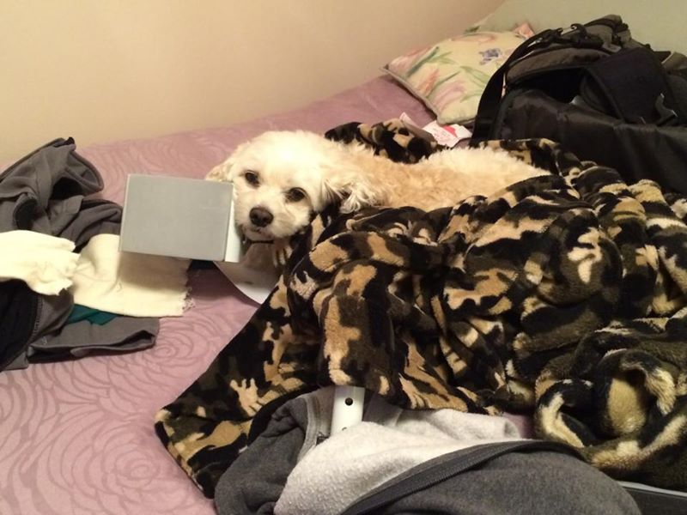
MULTIPLICATION
Notes:
I’d like to introduce you to multiplication.
Multiplication is where, for lots of people, math became something to memorize.
Well, memorizing is a good thing, and that’s a big part of this little course.
We’re going to approach it, though, from understanding numbers and how they work. It’s like riding a bike or driving a car – it’s good to know how to use it, but it’s even better to understand how it works.

Slide 3
If I don’t remember times tables, or I never knew them, why should I try to learn them now? When would I use them?
Really ☺ It’s worth giving it a try ☺
Notes:
Why should you bother?
It’s an investment – work harder now, work easier later.
especially because understanding makes the brain remember things better.
You just might surprise yourself.

Slide 4
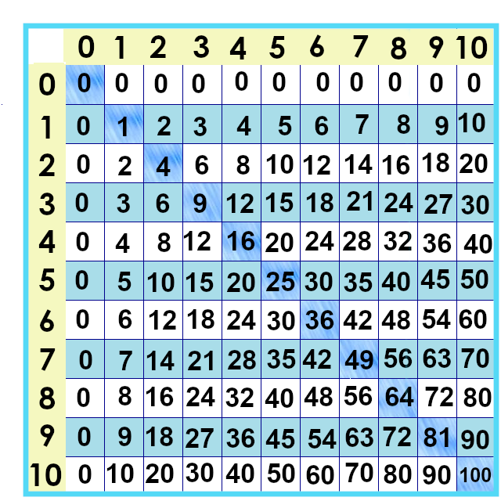
Let’s learn the facts... And build understanding.
Notes:
Here are the times tables lined up in a chart.
To find 5 x 5 we find where the 5 row and 5 column cross --

Slide 5
5 x 5 = ?? .
Notes:
BUT!!! We want to get to where you don’t even need to use a chart. 5 x 5 will always be 25... We’ll use this to keep track of the ones you’re learning.
There are 121 facts on the chart – next lesson – knocking off the first 21 ☺

Slide 6
Yes, you can download, share, &/or change this if you:
Please attribute to Susan Jones with a link to http://www.resourceroom.net
Except where otherwise noted, this work is licensed under https://creativecommons.org/licenses/by/4.0/
This license lets others modify work even for commercial purposes, as long as credit is given to me. See https://creativecommons.org/licenses/ for more information & links to the license deed and legal code.
My email is sue@resourceroom.net
or sujones@parkland.edu
Notes:
http://www.achieve.org/EQuIP
http://creativecommons.org/tag/k12-oer-collaborative

