Slide 1
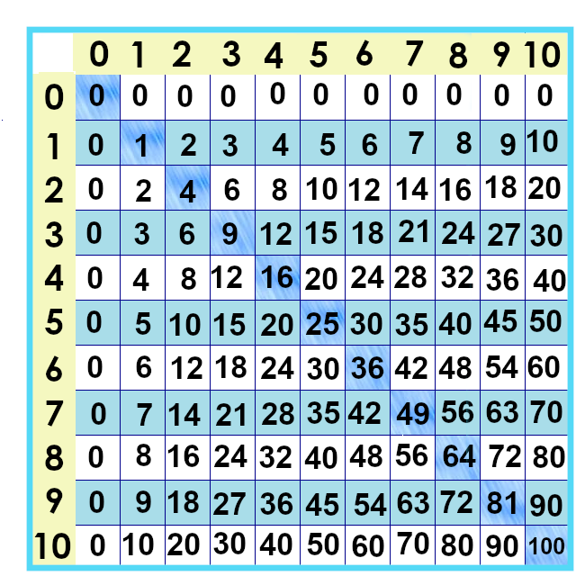
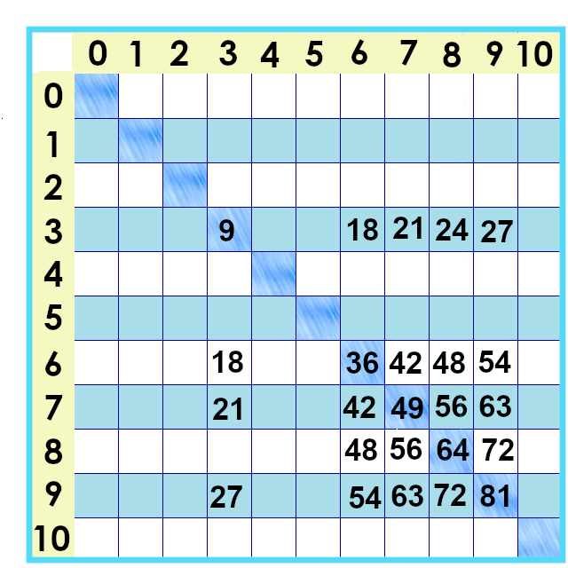
Notes:
Okay! If you’ve been keeping up, you’ve learned a whole lot of the times tables already You’ve learned 96 --
You’ve got 25 to go!
These are the ones that are left. We’ll tackle the nines next!

Slide 2
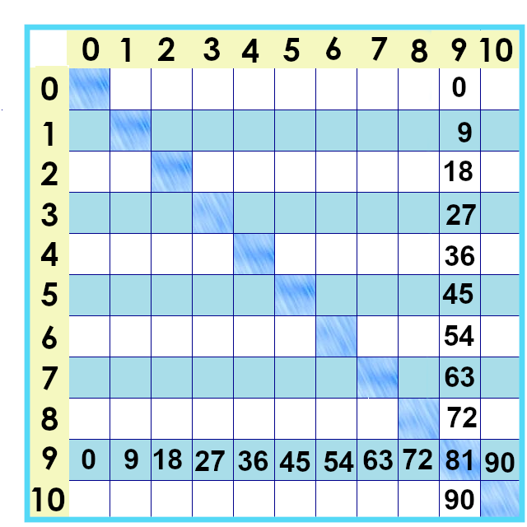
Notes:
Let’s take a look at a big one – the nines! Here’s what they look like on the times tables chart – 9 x 9 is 81....

Slide 3
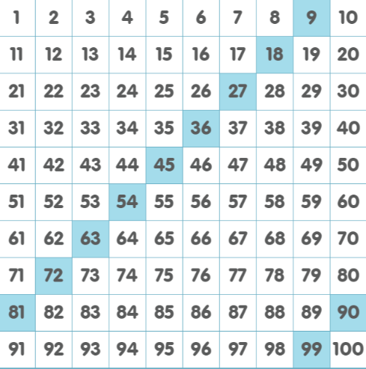
Notes:
Here’s what the nines times tables look like on the number chart. 9 x 1... Add nine more for 9 x 2.... Add nine more.... See a pattern here?

Slide 4
29
+10
39
Notes:
To add ten to a number doesn’t change how many ones there are... Just the tens. So... 9 + 10 is 19. + 10 is 29... + 10 is 39/// and so on.
One way to add nine to a number is to ... Add ten, and then back up one. So if you remember that 9 x 2 is 18 because you memorized your twos facts... You can figure out 9 times three by thinking “18 +10 is 28... Back up one for 27. Nine times 3 is 27.

Slide 5
Notes:
Here’s another pattern.
Remember figuring out 9 x 4? 10 x 4 is 40... Then take away four?
For 9 x 5 – 10 times five is 50... Back up 5.
For 9 times 6.... You could take your 45 + 10 is 55 and back up 1... 54... 9 x 6 is 54....
Or you could say “10 x 6 is 60” and back up six.... 9 x 6 is 54... 9 x 7 is (show on the thing...) 63///
9 x 8 os 72
9 x 9 is 81 and 9 x 10 is 90. No backing up for that one.

Slide 6
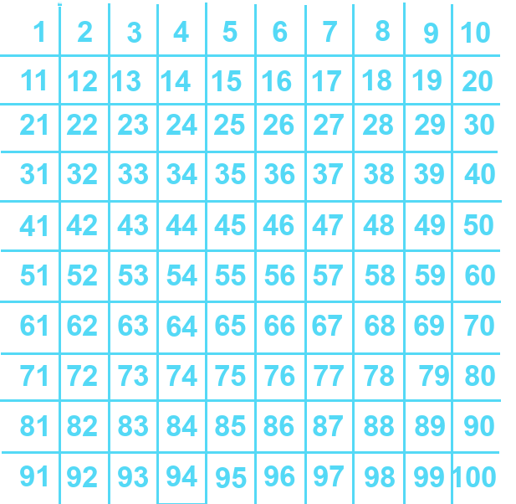
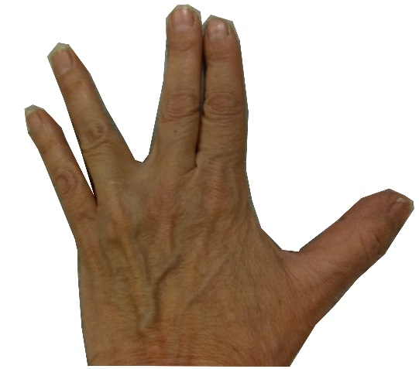
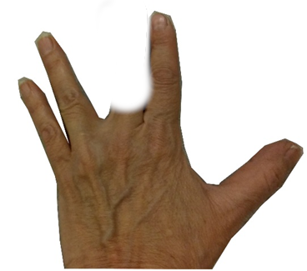
20
10
Notes:
Now, there’s a way to do this “backing up” thing so you’re always counting forward. with your fingers. Let’s say you want to know what 9 x 3 is.
You know it’s not 30 – that’s too big, that’s 10 times 3. So! Put that finger *down.* Count by tens – but stop before the one you know is too big!
Ten... Twenty.

Slide 7
30 – 3 =
30 – 10 + 7
1
4
5
20
6
10
3
7
2
Notes:
We know our answer will be 20 *something.*
We needed to back up 3 from 30... But that happens to be exactly the same as backing up 10 and adding 7.
... And That happens to be exactly how
many fingers are on the other side of the one we took away. So to get the answer to a nines fact:
Put down the finger of the fact you’re looking for. Count by tens on the left side – 10, 20 – because the finger you put down would be too big.
Leap over that finger and then count forward by one. 21, 22, 23, 24, 25, 26, 27.
So 9 x 3 is 27.

Slide 8
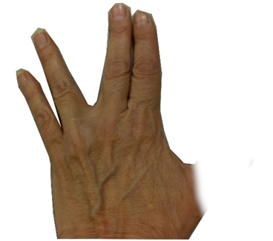
30
2
3
40
4
20
10
5
1
Notes:
9 x 5 .... You might remember it’s 45 – but... Put down the fifth “finger... Your thumb... So you’re backing off 10 from 50 ... 10 20 30 40... Leap over to the ones side.... 41, 42, 43, 44, 45. Tha’ts right, 9 x 5 is 45.
Oh, and one more thing to notice: the digits of the numbers– the 4 and the 5, the 2 and the 7? They will add up to 9, all the time.
If you want to know if you can divide anumber by nine? Add up the digits. If your answer, the sum, is 9 -- or if you can divide it by nine – then your number is divisible by nine. That’s peeking ahead at a different lessn.

Slide 9
9 x 0 = 0
9 x 1= 9
9 x 2 = 18
9 x 3 = 27
9 x 4 = 36
9 x 5 = 45
Notes:
One thing you can do to study these – besides taking practice quizzes – is to cover them up and say the next one ... Cover it up and say it from your memory... 9 x 3 is 27...

Slide 10
9 x 0 = 0
9 x 1= 9
9 x 2 = 18
9 x 3 = 27
9 x 4 = 36
9 x 5 = 45
Notes:
9 x 2 is ...18 9 x 3 is.... Hmmm... 28, back up 1... 27...

Slide 11
9 x 0 = 0
9 x 1= 9
9 x 2 = 18
9 x 3 = 27
9 x 4 = 36
9 x 5 = 45
9 x 6 = 54
9 x 7= 63
9 x 8 = 72
9 x 9 = 81
9 x 10 = 90
Notes:
It’s worth taking the time to do it. Work hard now – work easy later! Next up – the threes!!

Slide 12
Yes, you can download, share, &/or change this if you:
Please attribute to Susan Jones with a link to http://www.resourceroom.net
This work is licensed under https://creativecommons.org/licenses/by/4.0/
This license lets others modify work even for commercial purposes, as long as credit is given to me. See https://creativecommons.org/licenses/ for more information & links to the license deed and legal code.
My email is sue@resourceroom.net
or sujones@parkland.edu
Notes:
Thelegal stuff...

