Slide 1
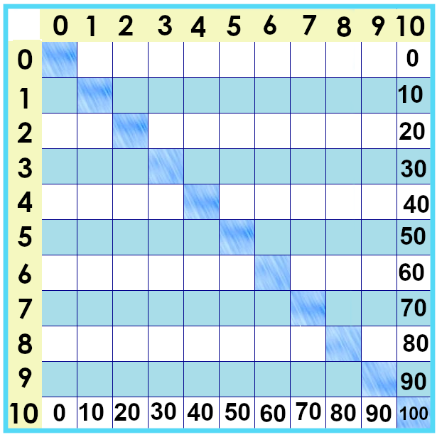
Notes:
The next set of facts … are the biggest ones on our chart. The tens times tables.
0 x 10 is 0.... 1 x 10 is 10.... 2 x 10 is 20.... 10 x 10 is 100....
What do you notice about them?
The facts are “counting by tens”: 10, 20, 30, 40, 50, etc.

Slide 2
Notes:
We can show the tens times tables as groups of objects... But ... Ten is such a big group that it’s hard to see how much there is.
“three groups of ten” -- I can tell they’re the same amount, but that’s overwhelming!
But... What if we organized them differently? What about this?
Lots of learning math is about figuring out how to arrange things so they make sense in *your* mind.
It’s also important to learn different ways that different ideas are shown.

Slide 3
Notes:
But... What if we organized them differently? What about this?
Lots of learning math is about figuring out how to arrange things so they make sense in *your* mind.
If we remember “counting by tens,” then ... We can see these and say “10 x 3 ... 10, 20, 30.... 10 x 3 is 30.”

Slide 4
0
0 x 10 =
1 x 10 =
10
2 x 10 =
20
3 x 10 =
30
40
4 x 10 =
Notes:
But... What if we organized them differently? What about this?
Lots of learning math is about figuring out how to arrange things so they make sense in *your* mind.
If we remember “counting by tens,” then ... We can see these and say “10 x 3 ... 10, 20, 30.... 10 x 3 is 30.”

Slide 5
7 x 10 =
70
5 x 10 =
50
8 x 10 =
80
9 x 10 =
90
6 x 10 =
60
10 x 10 =
100
Notes:
But... What if we organized them differently? What about this?
Lots of learning math is about figuring out how to arrange things so they make sense in *your* mind.
If we remember “counting by tens,” then ... We can see these and say “10 x 3 ... 10, 20, 30.... 10 x 3 is 30.”

Slide 6
Notes:
About noticing things ... And zeroes... That’s its own lesson.

Slide 7
Yes, you can download, share, &/or change this if you:
Please attribute to Susan Jones with a link to http://www.resourceroom.net
This work is licensed under https://creativecommons.org/licenses/by/4.0/
This license lets others modify work even for commercial purposes, as long as credit is given to me. See https://creativecommons.org/licenses/ for more information & links to the license deed and legal code.
My email is sue@resourceroom.net
or sujones@parkland.edu
Notes:
http://www.achieve.org/EQuIP
http://creativecommons.org/tag/k12-oer-collaborative

