Slide 1
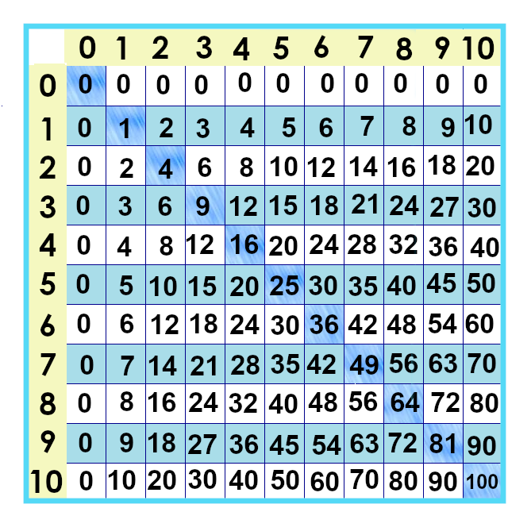
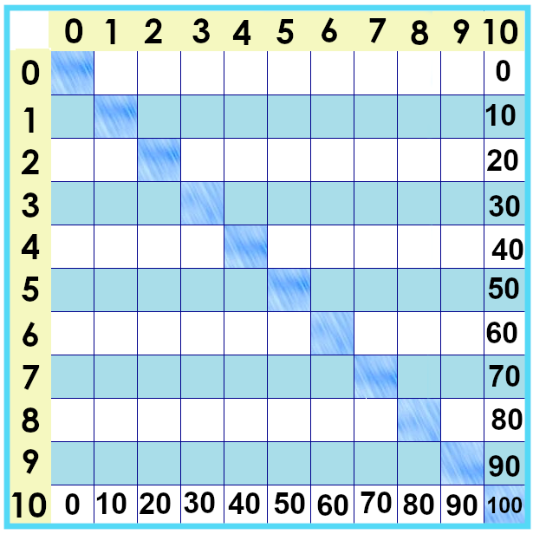
Notes:
The next set of facts … are the biggest ones on our chart. The tens times tables.
0 x 10 is 0.... 1 x 10 is 10.... 2 x 10 is 20.... 10 x 10 is 100....
What do you notice about them?
The facts are “counting by tens”: 10, 20, 30, 40, 50, etc.

Slide 2
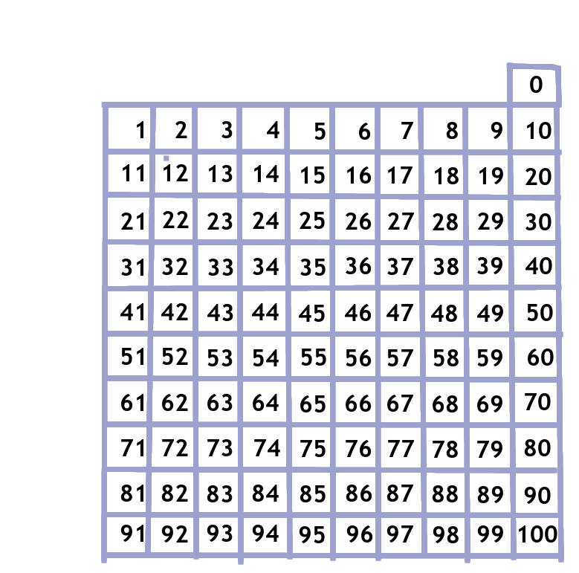
Notes:
These are the numbers 0 through 100, arranged in rows of 10. .
Let’s show the tens ttimes tables on this chart. We’ll shade every tenth number that will be our “tens times tables” facts.
Let’s learn about the tens.
We start at zero and bump down, ten at a time. (do it) 10 x 10 x
It’s sometimes called “counting by tens.”

Slide 3
Tens look like this
0 x 10 =
0
1 x 10 =
10
2 x 10 =
20
3 x 10 =
30
4 x 10 =
40
5 x 10 =
50
6 x 10 =
60
7 x 10 =
70
8 x 10 =
80
9 x 10 =
90
10 x 10 =
100
Notes:
These are the numbers 0 through 100, arranged in rows of 10. .
Let’s show the tens ttimes tables on this chart. We’ll shade every tenth number that will be our “tens times tables” facts.
Let’s learn about the tens.
We start at zero and bump down, ten at a time. (do it)
It’s sometimes called “counting by tens.”

Slide 4
Notes:
But you might have noticed something about multiplying by ten.... We’ll talk about that in the next video.

Slide 5
Yes, you can download, share, &/or change this if you:
Please attribute to Susan Jones with a link to http://www.resourceroom.net
This work is licensed under https://creativecommons.org/licenses/by/4.0/
This license lets others modify work even for commercial purposes, as long as credit is given to me. See https://creativecommons.org/licenses/ for more information & links to the license deed and legal code.
My email is sue@resourceroom.net
or sujones@parkland.edu
Notes:
http://www.achieve.org/EQuIP
http://creativecommons.org/tag/k12-oer-collaborative

