Slide 1
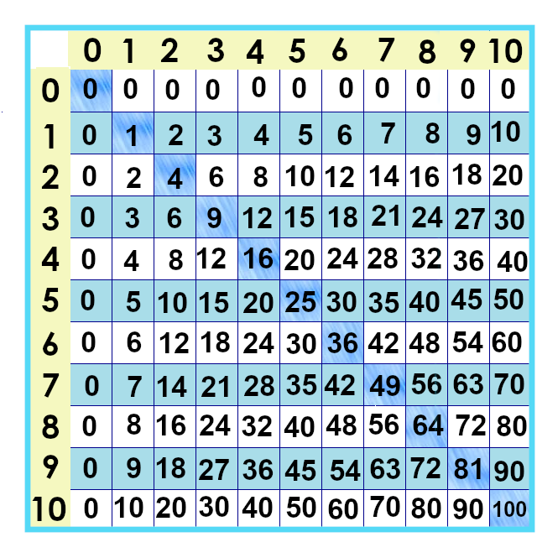
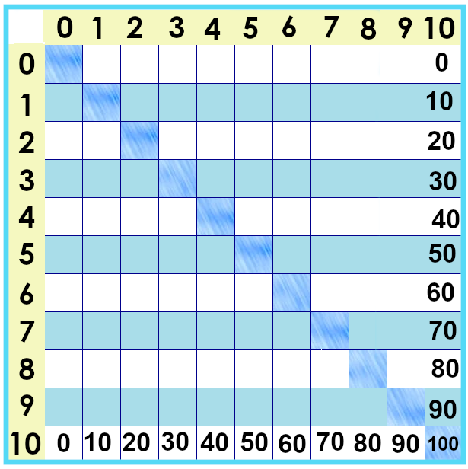
Notes:
These facts … are the biggest ones on our chart. The tens times tables.
What do you notice about them?
The facts are “counting by tens”: 10, 20, 30, 40, 50, etc.

Slide 2
Number lines --
Notes:
…. We can use a number line to show multiplying by ten : 10 x 1, 10 10 x 2, 20 .... 10 x 3 ... 30 by moving forward ten each time.
We had to shrink down the number line, though!

Slide 3
Number lines --
0 x 10 =
0
1 x 10 =
10
6 x 10 =
60
2 x 10 =
20
7 x 10 =
70
3 x 10 =
30
8 x 10 =
80
4 x 10 =
40
9 x 10 =
90
5 x 10 =
50
10 x 10 =
100
Notes:
…. We can use a number line to show multiplying by ten : 10 x 1, 10 10 x 2, 20 .... 10 x 3 ... 30 by moving forward ten each time.
Now, if you noticed something about zeroes.... That’s got its own movie.
OKAY, I am not ready to figure out the layout. Grr. Let’s get this part done.
Okay, but the quizzes!!! Yes we will do them after we get the tens done.

Slide 4
Notes:
But you might have noticed something about multiplying by ten.... That gets its own video.

Slide 5
Yes, you can download, share, &/or change this if you:
Please attribute to Susan Jones with a link to http://www.resourceroom.net
This work is licensed under https://creativecommons.org/licenses/by/4.0/
This license lets others modify work even for commercial purposes, as long as credit is given to me. See https://creativecommons.org/licenses/ for more information & links to the license deed and legal code.
My email is sue@resourceroom.net
or sujones@parkland.edu
Notes:
http://www.achieve.org/EQuIP
http://creativecommons.org/tag/k12-oer-collaborative

