Slide 1
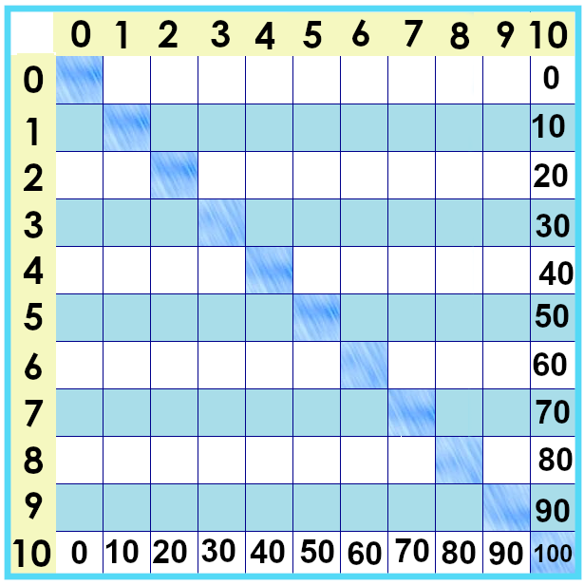
Notes:
Let’s take a look at the tens times tables. You might have noticed that to for these numbers, I can write the same number and then put a zero at the end... And that will be that number multiplied by ten.
Why is that? Can we say “when you multiply by ten, stick a zero at the end?”
Will it always work?

Slide 2
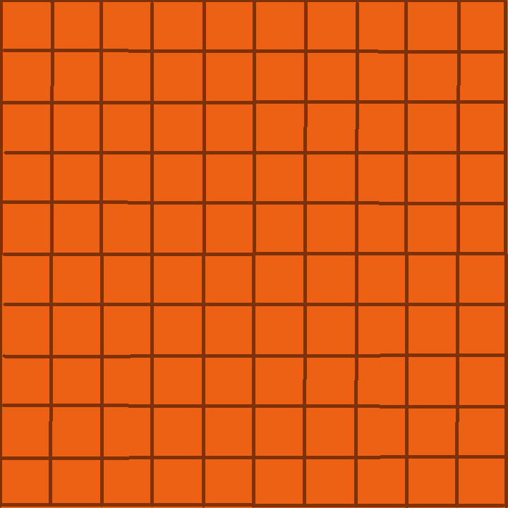


Each place is worth ten times as much as the one to its right.
10 x 100
10 x 10
10 x 1
100
10
1
1000
Notes:
Our number system is *based on* ten.
S0 10 is 10 x 1… ten tens make a hundred…. Ten hundreds make a thousand…
Writing a zero at the end fills the smaller space and makes the number worth ten times as much.

Slide 3
Works for all *whole* numbers
3 x 10 = 30
11 x 10 = 110
745 x 10 = 7450
.... But .... But ....
Notes:
A taste of some more advanced math – but if it doesn’t make sense yet, don’t sweat it ...

Slide 4


2.5 x 10 ....
  2.5 x 10 = 25
2 x 10
2.5 x 10
3 x 10
Notes:
Just so you know -- if I take a number in between 2 and 3, like ... 2 and a half... 2 .5 -- I need to move those digits to the bigger place.
2 ½ x 10 is 25 --- halfway between 2 x 10 and 3 x 10
But don’t get distracted! For times tables facts, the zero at the end does the job.

Slide 5
Yes, you can download, share, &/or change this if you:
Please attribute to Susan Jones with a link to http://www.resourceroom.net
This work is licensed under https://creativecommons.org/licenses/by/4.0/
This license lets others modify work even for commercial purposes, as long as credit is given to me. See https://creativecommons.org/licenses/ for more information & links to the license deed and legal code.
My email is sue@resourceroom.net
or sujones@parkland.edu
Notes:
The Legal Stuff

