Slide 1
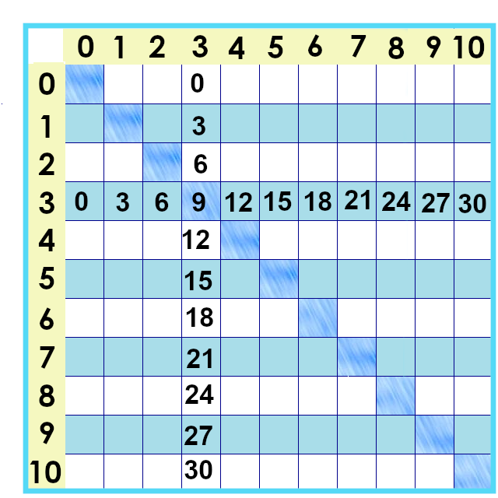
Notes:
Next up – the THREES!!! Here’s where they live on the times tables chart. 3 x 7 is 21... 7 x 3 is 21...

Slide 2
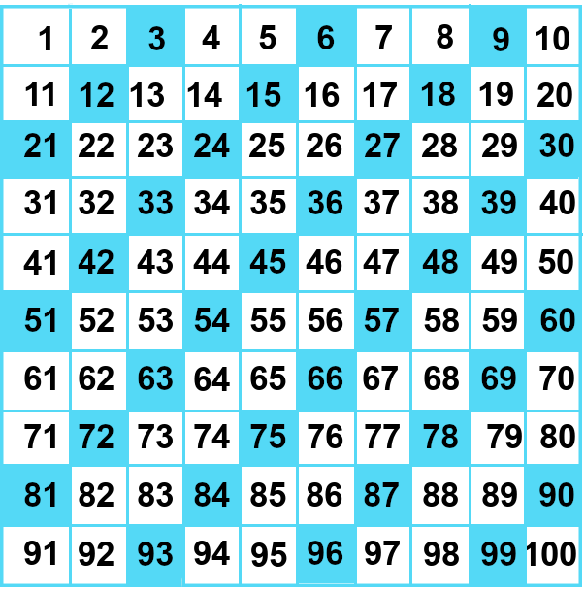

Slide 3
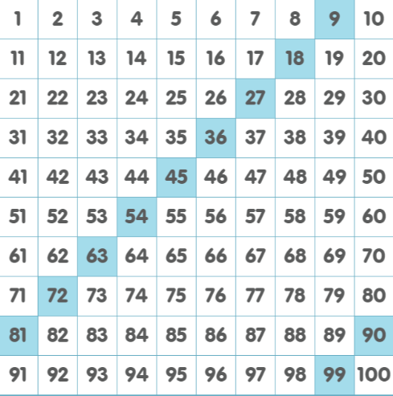
Notes:
Hmmm. Looks a lot like the nines times tables, doesn’t it?
All the multiplies of nine are also multiples of 3. How’s that work?

Slide 4
3² = 9
Three to the second power = 9
Three squared is 9
Notes:
Every group of nine has exactly 3 groups of 3 in it. We can arrange them as a square. We can talk about it in lots of different ways --

Slide 5
3 x 3 = 9
Notes:
For our multiplication facts, the only way we need to remember is:

Slide 6
Notes:
Let’s focus on the 3’s facts we need to know. If you’ve been practicing, then you already know some of them so I’m going to do a fast fade...

Slide 7
3 x 0 =
0
3 x 4 =
12
3 x 1 =
3
3 x 5 =
15
3 x 2 =
6
3 x 10 =
30
3 x 9 = 27
3 x 3 = 9
Notes:
3 x 0 = 0 ... 3 x 1 is 3, 3 x 2 is .... 6.
Our first new one – 3 x 3 is .... 3 squared or 9...
3 x 4 ... Double double... 12 and 3 x 5 is 15.
3 x 10 is ... 30, and back up 3 to remember 3 x 9 is 27.

Slide 8
Notes:
Fading back in ....
We can get to the rest of the ones we need to know by building from one we know. 3 x 5 is 15....
We can count forward – find a rhythm – to get the 3 more that will get the sixth group of 3. 15.... 16, 17 18.... 6 x 3 is 18.... 19, 20, 21.... 22, 23, 24...
3 x 7 is 21.... 3 x 8 is 24....

Slide 9
Notes:
Another fun little fact that will come in handy when you need to divide things:
Remember how the digits in the multiples of nine always added up to .... 1 + 8.... 2 + 7... 9?
That’s really handy because ... To see if 9 goes into a number... We can’t look at the last number. They go all over the place!
Let’s see what the digits of the 3’s multiples add up to. Hmmm.... We seem to have a pattenr here. If 3 goes into a number, its digits add up to 3 6 or 9. If you add up the digits, and you can divide that by 3 evenly... You can divide that number by 3.

Slide 10
51
5 + 1 = 6
51 ÷ 3 = 17
Notes:
Looking at the bigger numbers
3 + 3... 4 + 2... 5 + `....
Yes, 51 that looks like NOTHING would go into it evenly... ... Yes, you can divide that by three and not have any left over. 17 x 3 is exactly 511.
But you don’t need to remember that. You need to remember that 3 x 3 is 9 and 3 x 7 is 21.

Slide 11
Notes:
To get to the ones left over – 3 x 6, 3 x 7 and 3 x 8.... If you don’t remember them, you can build from 3 x 5. Find a rhythm: 3 x 5 is 15... 16 17 *18* -19 20 *21*, 22 23 *24*.... 6 x 3 is 18... 7 x 3 is 21.... 8 x 3 is 24.... 9 x 3 is 27... 10 x 3 is 30.

Slide 12
3 x 8 = 24
3 x 6= 18
3 x 7 = 21
3 x 3 = 9
3 x 4 = 12
3 x 5 = 15
Notes:
And of course you can put these on paper and say them... Cover them up and say them again.... 3 x 3 is 9, 3 x 7 is ... 21

Slide 13
3 x 0 = 0
3 x 1= 3
3 x 2 = 6
3 x 3 = 9
3 x 4 = 12
3 x 5 = 15
3 x 6 = 18
3 x 7= 21
3 x 8 = 24
3 x 9 = 27
3 x 10 = 30
Notes:
Yes, I’ve said it before: It’s worth taking the time to do it. Work hard now – work easy later! Next up – the sixes!

Slide 14
Yes, you can download, share, &/or change this if you:
Please attribute to Susan Jones with a link to http://www.resourceroom.net
This work is licensed under https://creativecommons.org/licenses/by/4.0/
This license lets others modify work even for commercial purposes, as long as credit is given to me. See https://creativecommons.org/licenses/ for more information & links to the license deed and legal code.
My email is sue@resourceroom.net
or sujones@parkland.edu
Notes:
Thelegal stuff...

