Slide 1
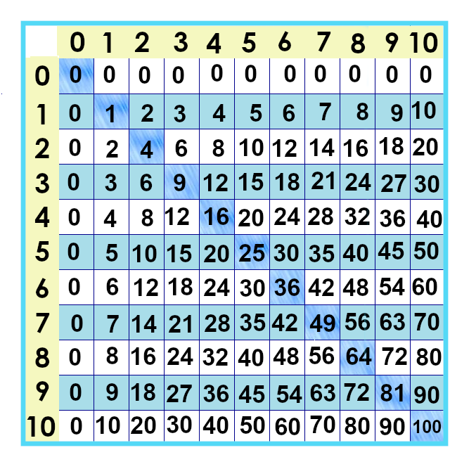
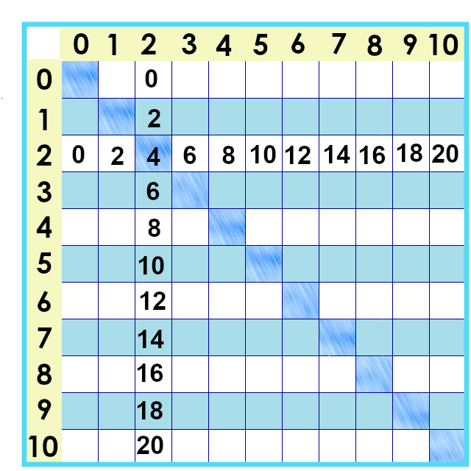
Notes:
This is what the twos look like on the times tables chart.
Let’s talk about the inverse operation: division.

Slide 2
Notes:
2, 4,6,8,10,12,14,16, 18,20
If things can be split into pairs, we say they’re even numbers. They’re divisible by two.
2 x 5 is 10....
2 x 8 is 16....

Slide 3
2
4
6
8
10
$$\frac{2}{2}=1$$
$\frac{10}{2}=$5
Notes:
we can look at them in arrays, too. All of these numbers – 2, 4, 6, 8 and 10 – are divisible by two.

Slide 4
$\frac{27}{2}=$13 ½
Notes:
If we try to divide 27 by two, though.... It’s not an even array.

Slide 5
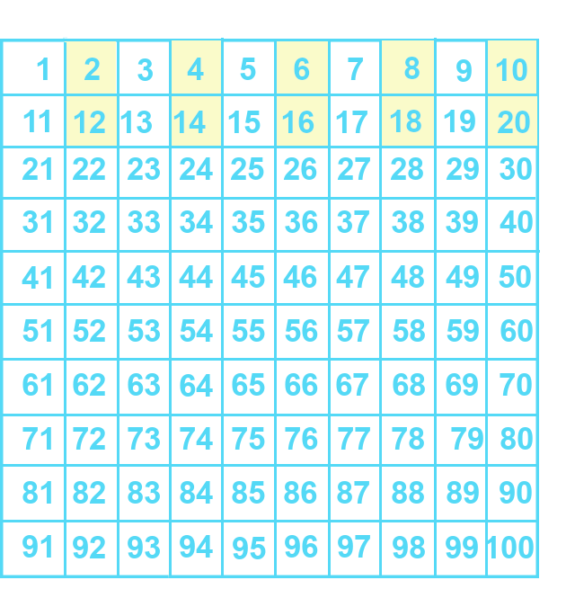
Notes:
... Here are the twos facts on the numbers chart... Do you notice a pattern? Does something repeat itself?

Slide 6
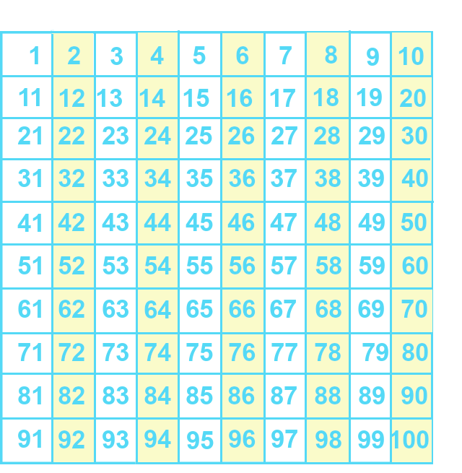
Notes:
If we keep going with bigger numbers, does the pattern continue?
These are all what are called “even” numbers and ... They all end in 2, 4, 6, 8 or 0 – they all end in an even number.
This is what *all* the multiples of two look like on the number chart.

Slide 7
Notes:
Why does this work?
Think about division as ... Repeated subtraction. Look at 14.

Slide 8
14 = 10 + 4
Notes:
7 x 2 is 14... I could take the twos away ... Two socks at a time ... I can do that 1, 2, 3, 4, 5, 6, 7 times.
But ... If I just want to know *whether* I can split them into pairs... I can break them up. I know 10 is 5 x 2, so BYE BYE!
4 are left... Since I can split them evenly, the whole number is even.

Slide 9
Notes:
Once more with a bigger number: 74.

Slide 10
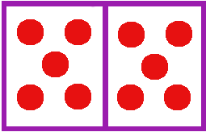
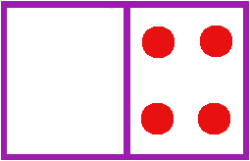
74
Notes:
I’m not trying to figure out how many groups of two I have in a number – not yet! – but ... I know every group of ten can be put into two even groups of five. So... If I want to know if 74 is divisible by two... I *know* 70 is, so I can just take them away.
I can split the four into two groups of two.
Do you think this will work for numbers with hundreds? Thousands? Can you split 100 evenly in half?

Slide 11
A whole number
is divisible by 2
if the last digit
is
2,4,6,8 or 0
Notes:
Wrapping it all up with another look at the number chart – if the digit in the ones spot ends in 2, 4, 6, 8 or 0, that whole number is divisible by two. We are able to divide it by two and get a whole number as our answer.

Slide 12
Yes, you can download, share, &/or change this if you:
Please attribute to Susan Jones with a link to http://www.resourceroom.net
This work is licensed under https://creativecommons.org/licenses/by/4.0/
This license lets others modify work even for commercial purposes, as long as credit is given to me. See https://creativecommons.org/licenses/ for more information & links to the license deed and legal code.
My email is sue@resourceroom.net
or sujones@parkland.edu
Notes:
http://www.achieve.org/EQuIP
http://creativecommons.org/tag/k12-oer-collaborative

