Slide 1
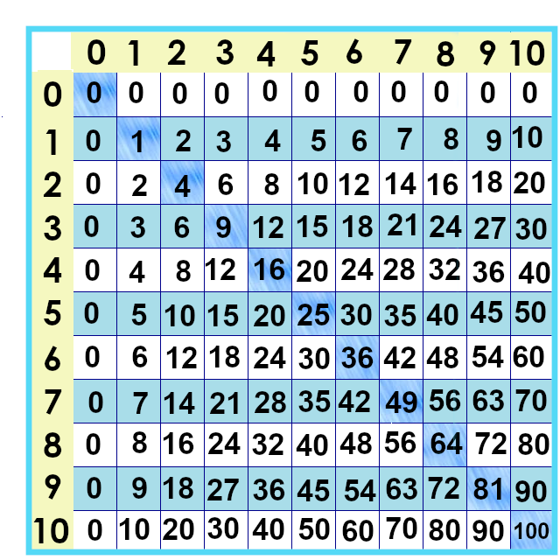
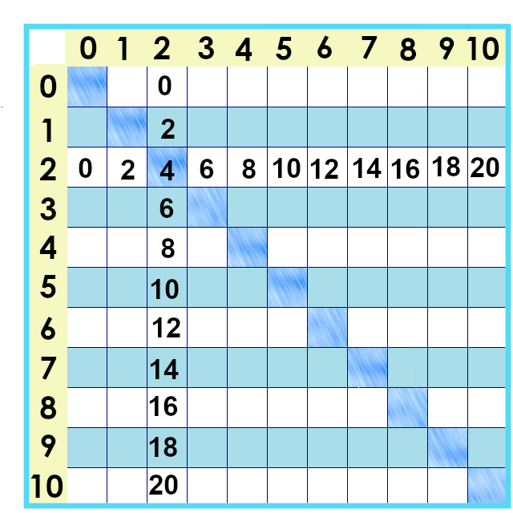
Notes:
The next group of facts we’ll tackle are the twos times tables.
These don’t get very big ☺ We can also say “It’s twice as much” or “double that number,” to mean the same thing as “multiply by two.
We can also “count by twos” to get to these.

Slide 2
Notes:
…. We can show the twos facts with groups of objects. We’re sort of “seeing double.”
So... If the Mary Ellen Carter Academy is getting school socks made. . .
2 x 1

Slide 3
0 x 2 =
0
1 x 2 =
2
6 x 2 =
12
2 x 2 =
4
7 x 2 =
14
3 x 2 =
6
8 x 2 =
16
4 x 2 =
8
9 x 2 =
18
5 x 2 =
10
10 x 2 =
20

Slide 4
Notes:
So, there they are! The two facts are called “even numbers,” because we can split them into two even parts.

Slide 5
Notes:
Once you’ve mastered the twos.... The ones left to learn are shrinking!! 7 rows and 7 columns .... 49 left to go! You’ve already learned 72.... More than half way there...

Slide 6
Yes, you can download, share, &/or change this if you:
Please attribute to Susan Jones with a link to http://www.resourceroom.net
This work is licensed under https://creativecommons.org/licenses/by/4.0/
This license lets others modify work even for commercial purposes, as long as credit is given to me. See https://creativecommons.org/licenses/ for more information & links to the license deed and legal code.
My email is sue@resourceroom.net
or sujones@parkland.edu
Notes:
http://www.achieve.org/EQuIP
http://creativecommons.org/tag/k12-oer-collaborative

