Slide 1
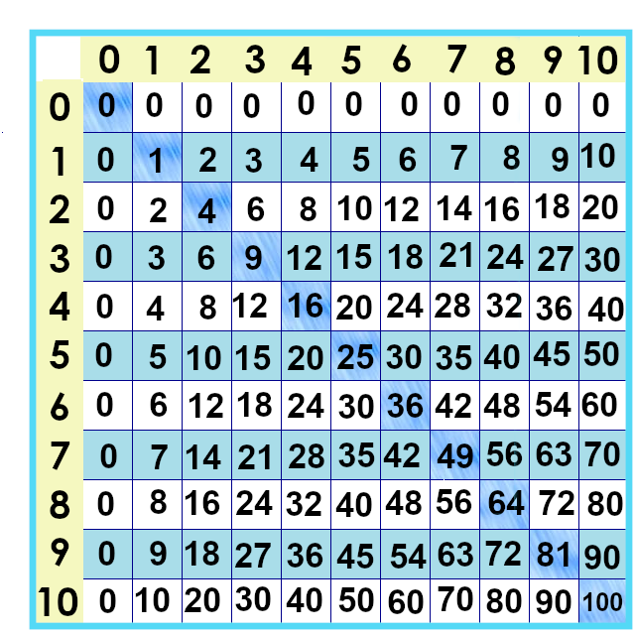
Zero Times Tables
Notes:
Let’s tackle the first row and column on the chart: the zeroes. NOTE: I REVISED THIS BAD BOY AFTER MAKING THE FIRST VIDEO. WHATEVER.

Slide 2
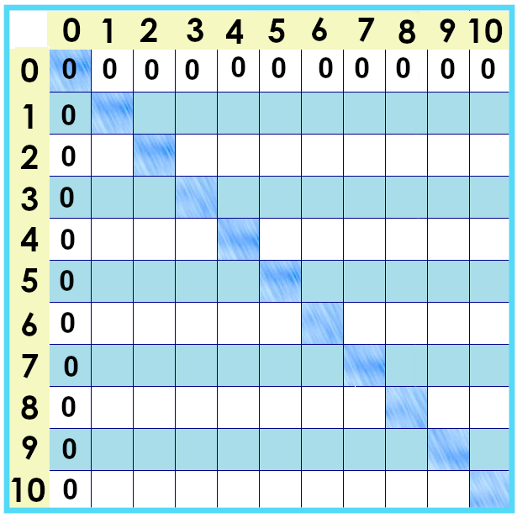
Notes:
What do you notice about the answers to the zeroes multiplication facts?
Let’s talk about why this is true.

Slide 3
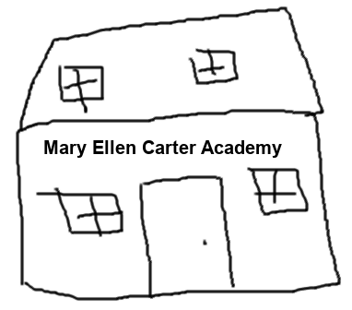
Multiplication as repeated addition
5 miles for round trip
Notes:
One way to think about multiplication is as repeated addition.
So, at MEC school, Furley rides his bike 5 miles a day to get to school and back.

Slide 4
Multiplication as repeated addition
5 miles
5 miles
5 miles
5 miles
5 miles
Notes:
He goes to school five days a week… so each day he’s riding 5 miles.
We can count each mile…. One at a time… which would take a while. In our minds, we can make the jump five times: 5 + 5 + 5 + 5 + 5 … to get to 25. Five times five is 25…..

Slide 5
Multiplication as repeated addition
0 miles
0 miles
0 miles
0 miles
0 miles
Notes:
We can do that with anything we do more than once …. Even if we’re doing NOTHING again and again.
Mizea (rhymes with Isaiah) actually lives in the little apartment they created upstairs on the second floor. They’re in an old school building – but only 45 students so the second floor was empty…
So… we could add 0 + 0 + 0 + 0 + 0 … and realize that Mizea … doesn’t have to ride any miles. 5 x 0 is 0.
Guess what? It doesn’t matter how many times you do nothing…. It’s still… nothing. 0 times a million is zero.
It doesn’t matter how big your idea is – maybe you wanted to ride 300 miles – but if you didn’t ride, you didn’t ride.

Slide 6
Notes:
It doesn’t matter what you think about doing… if you don’t do it, you’re still at zero.

Slide 7
0 + 0 + 0 + 0
4 x 0
0
Notes:
So… we’ve seen three ways to show multiplication: repeated addition and on a number line and as a multiplication expression.
They are all different ways of saying “zero.” Anything times zero is … zero!!

Slide 8
Quiz time!!!
0 x 3 = ____
0 x 2 = ____
0 x 9 = ____
0 x 10 = ____
0 x 8 = ____
0 x 1 = ____
0 x 7 = ____
0 x 0 = ____
0 x 4 = ____
0 x 5 = ____

Slide 9
Quiz time!!!
0 x 3 = _0___
0 x 2 = 0
0 x 9 = _0___
0 x 10 = _0___
0 x 8 = ___0_
0 x 1 = ___0_
0 x 7 = __0__
0 x 0 = __0__
0 x 4 = __0__
0 x 5 = _0___
(and 5 x 5 = 25)
Notes:
No surprise… the answers are all… zero -- oh, and 5 x 5 is still 25.

Slide 10
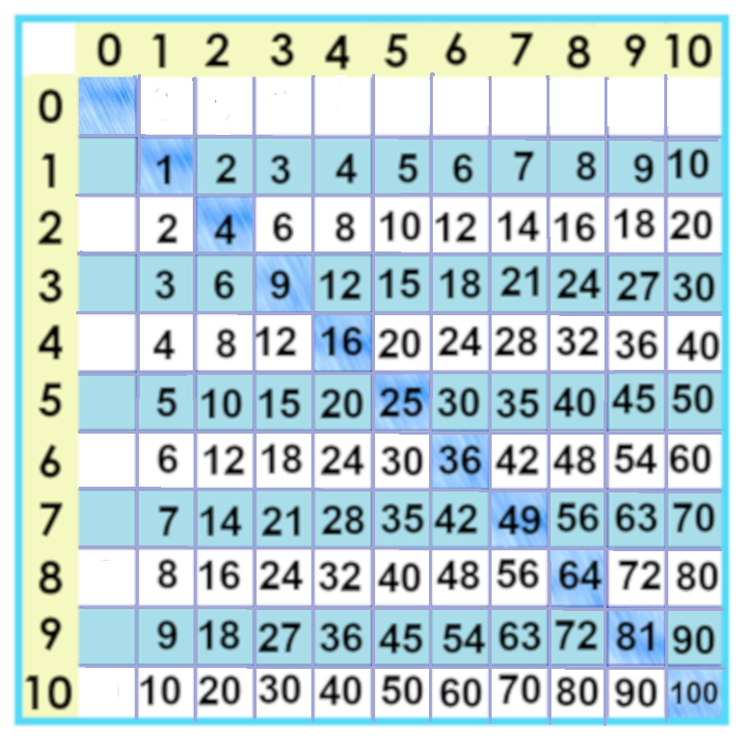
25
Notes:
Okay 21 facts down… 100 to go. 99 if you remember 5 x 5 is 25… We’ll tackle 19 more in the next one ☺

Slide 11
Yes, you can download, share, &/or change this if you:
Please attribute to Susan Jones with a link to http://www.resourceroom.net
This work is licensed under https://creativecommons.org/licenses/by/4.0/
This license lets others modify work even for commercial purposes, as long as credit is given to me. See https://creativecommons.org/licenses/ for more information & links to the license deed and legal code.
My email is sue@resourceroom.net
or sujones@parkland.edu
Notes:
http://www.achieve.org/EQuIP
http://creativecommons.org/tag/k12-oer-collaborative

Slide 12
2 ½ miles
2 ½ miles
Total 5 miles for round trip
Notes:
One way to think about multiplication is as repeated addition.
So, at MEC school, Furley rides his bike 5 miles a day to get to school and back. Half of 5 is 2 and a half--- I put the number line up there in case you’re curious about how that works but if that doesn’t make sense yet, don’t worry about it. We’ll learn more about fractions later.

