Slide 1
Absolutely, Positively Absolute Value!

Slide 2
Negative numbers
Are the opposite of positive numbers.
-4
+4

Slide 3
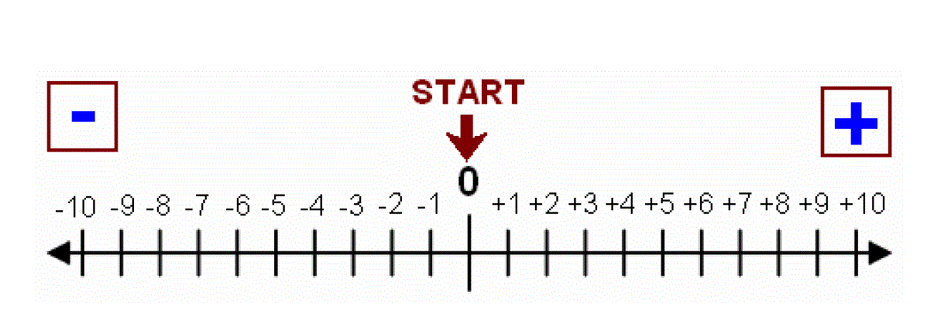
But sometimes…
All we want to know is how far away ZERO is.
-4
+4

Slide 4
… or, “forget the sign, how BIG are you???”

Slide 5
“What’s the absolute value of this number?”
Means
“How far is that number from zero?”
Direction doesn’t matter: how many steps (one ‘unit’ each) must you take to get there?

Slide 6
How far is 4 from zero?
+4

Slide 7
How far is 4 from zero?
+4

Slide 8
So, in the language of math
Because 4 is 4 units away from zero,
“The absolute value of 4 is 4”
Or, |4| = 4

Slide 9
The translation?
“The absolute value of 4 is 4”
|4| = 4

Slide 10
The translation?
“The absolute value of 4 is 4”
|4| = 4

Slide 11
The translation?
“The absolute value of 4 is 4”
|4| = 4

Slide 12
The translation?
“The absolute value of 4 is 4”
|4| = 4

Slide 13
The translation?
“The absolute value of 4 is 4”
|4| = 4

Slide 14
The translation?
“The absolute value of 4 is 4”
|4| = 4

Slide 15
Match the “math language” to the words below:
|-7| = 7 ____
|-5| = 5 ___
|5| = 5 ____
|7| = 7 ____
The absolute value of 7 is 7
The absolute value of negative 7 is 7.
The absolute value of 5 is -5.
The absolute value of -5 is 5.
The absolute value of 5 is 5.

Slide 16
Now for the “change your way of thinking” one…
How far is -4 from zero?
-4
+4

Slide 17
From a different direction, but…
-4 is four units from zero.
-4
+4

Slide 18
So…
|-4| = 4
Since -4 is 4 ‘steps’ from zero… its absolute value is Plain Old 4… Positive 4.

Slide 19
Discovery time!
What’s the pattern?
|-7| = 7
|7| = 7
|-5| = 5
|5| = 5
|100| = 100
|-100| = 100

Slide 20
Positive *or* negative…
Doesn’t matter. The answer is POSITIVE.

Slide 21
Want to dig deeper?

Slide 22
The absolute value of *what* is 3?
The absolute value of *what* is 3?
Or… In math…
|x| = 3
What could x be?

Slide 23
|3| = 3
|-3| = 3
There are two possibilities.

Slide 24
The dramatic, soap opera version…
Absolute Value Land

Slide 25
The soap opera version…
The absolute value bars are the lovely fence around Absolute Value Land.
When you’re in Absolute Value Land, you can do what you wish, positively or negatively.
However, when you leave Absolute Value Land (and shake off your fence bars), you MUST MUST MUST become positive.
What happens to you outside Absolute Value Land… we have no control over.

Slide 26
Absolute Value Land
You must be positive to get out ☺
(but after that… it’s whatever the symbols say to do…)

Slide 27
How on earth will I ever remember this?
Are you alone?
When you see that absolute value sign, LEAP into the air like a referee at a football game and make that touchdown sign
Say “Touchdown, Absolute Value! Always Positive!”
Go out and do this in public. Or not ☺ ☺ ☺ … but you’d remember!
Or… make a flashcard and study. Maybe put the touchdown image on it…

Slide 28
Your turn! Ace this quiz! ☺
|-7| = __
|-8| = __
|15| = __
|-15| = __
|-32| = __
|32| = __
|4| = __
|-4| = __

