Slide 1
Finding Wholes
Adding: Part + Part = Whole
Multiplying: Part X Part = Whole

Slide 2
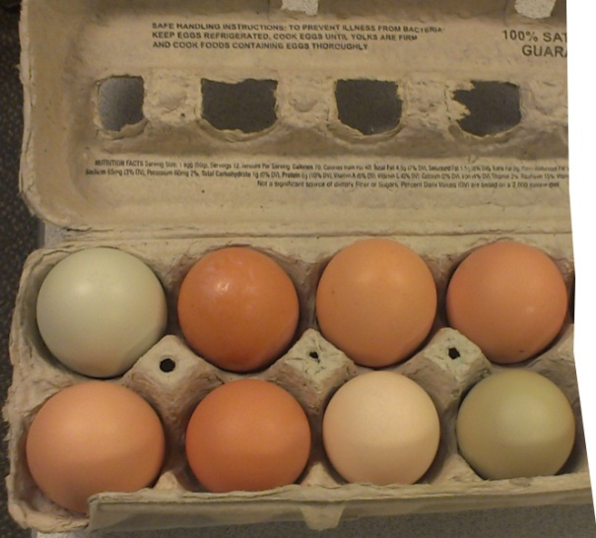
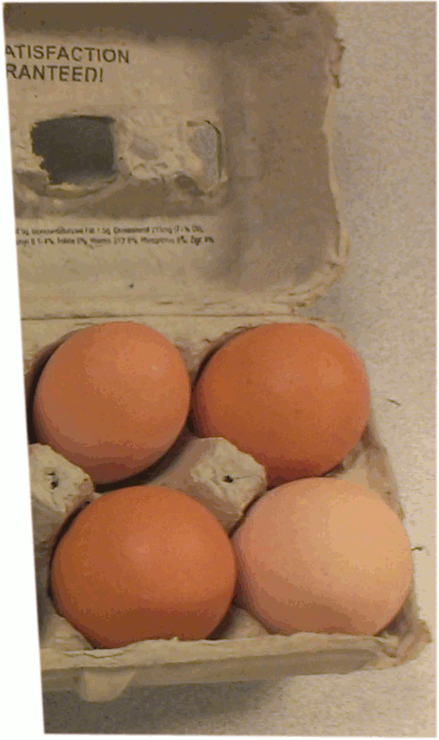
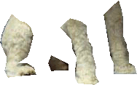
2 important ways to put parts together to get wholes:
Adding: Part + Part = whole
Or part + part + part = whole

Slide 3
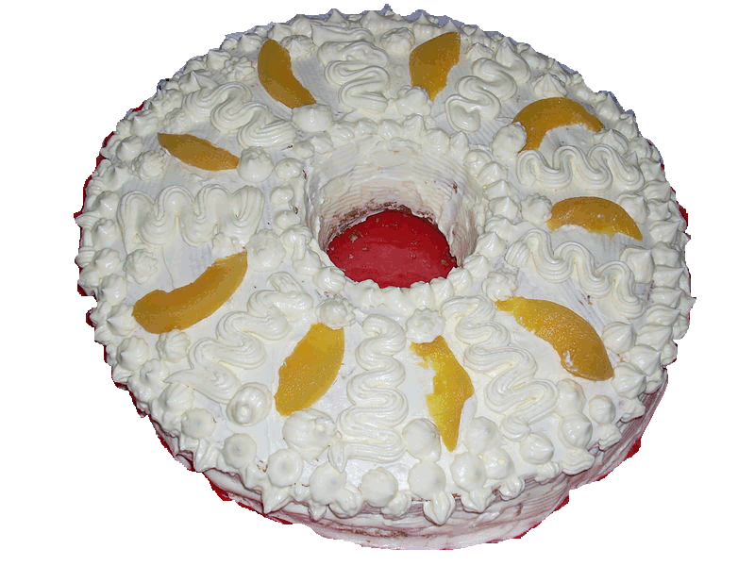
The converse is true, too:
Whole = part + part

Slide 4
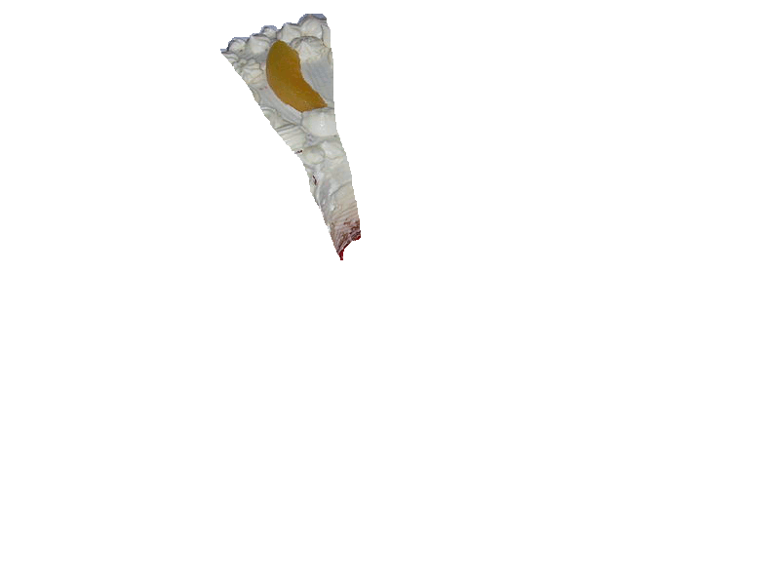
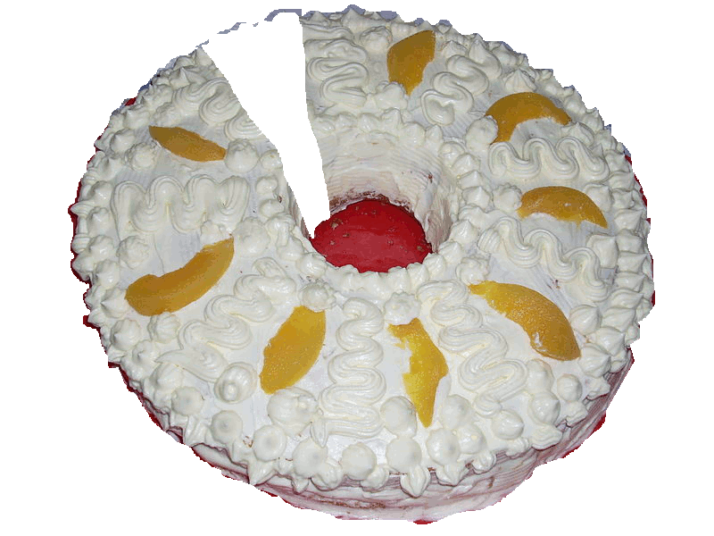
Same pie, two ways of talking about it.
Whole = part + part

Slide 5
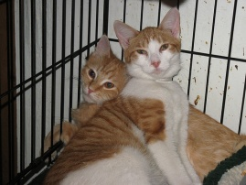
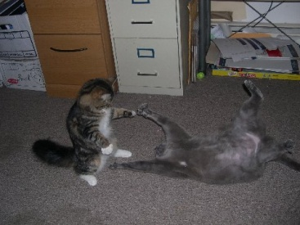
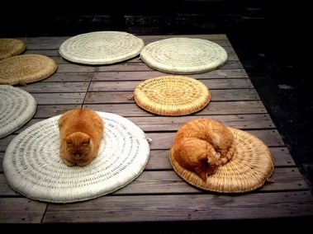
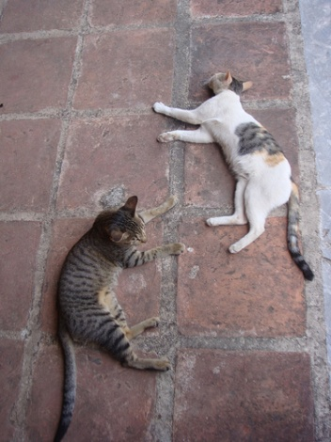
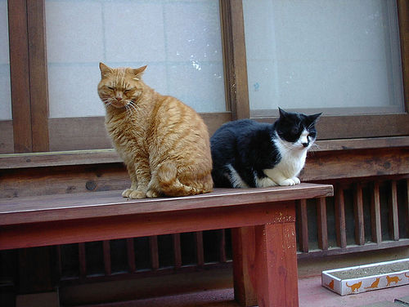
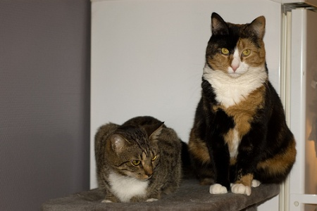
Ways to put parts together to get wholes:
Multiplying: part x part = whole
6 x 2 = 12

Slide 6
Part times part … rows x columns… 5 x 5 = 25

Slide 7
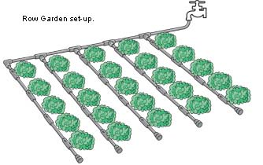
and yes, it can be part x part x part: 5 rows x 5 columns x 4 garden plots = 100 broccoli plants! YUMMMMM!

Slide 8
We can think of the “whole” in multiplication as groups, of the same size, happening different *times.*

Slide 9
Here we’ve got 5 columns of 3 bags of charcoal…

Slide 10
… or 3 rows of 5 bags of charcoal
the parts and the wholes are there… at the same time…

Slide 11
How to tell which is which?
Read the problem carefully and imagine what’s happening in it. If you’re putting things together and asking what you’ve got, you’re probably putting parts together to make a whole.

Slide 12
Adding Examples:
8 Eggs + 4 eggs = 12 eggs
Gravity’s head + Gravity’s legs + Gravity’s body = the whole Gravity
The whole whipped cream pie = one slice of whipped cream pie plus the rest of the whipped cream pie.
NOTICE: You’re adding the *same thing* to the *same thing.* It’s same to same in the addition game.

Slide 13
Multiplying Examples
5 rows of broccoli x 5 columns of broccoli = 25 broccoli plants.
2 cats x 6 pictures = 12 cats.
3 rows of 5 bags of charcoal.
Multiplying is more powerful and abstract than adding… but you do *not* have to be multiplying the same thing by the same thing. I have 2 cats x 6 pictures; 3 bags of charcoal x 5 columns that big.

Slide 14
Addition or multiplication?
typical addition key words
typical multiplication key words
altogether
combined
more
extra
increase
plus
sum
total
add
and
in all
of
product
multiply
times
by
twice
as much
each
per
every
Notes:
Have them separate *pictures* of adding and multiplying into those respective categories
Then have them *match* the pictures to the symbols
Then tell stories and have them match the stories to the pictures
Then, finally, TELL THE STORIES>
ALSO ALSO MAKE A CONCEPT CARD WITH A PICTURE OF ADDITION AND A PICTURE OF MULTIPLICATION BOTH CONCRETE AND ON THE NUMBER LINE.

Slide 15
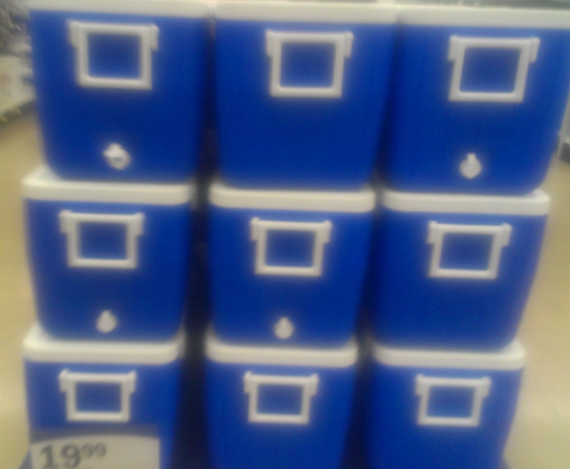
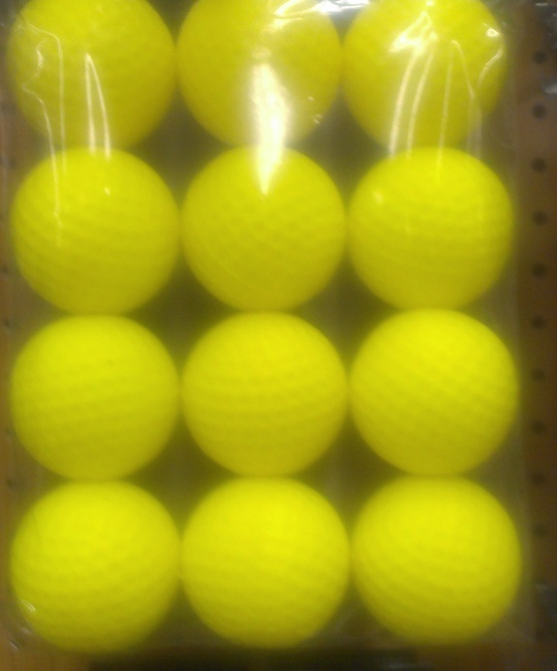
Can you make a multiplication equation with two parts and a whole for these pictures?

Slide 16
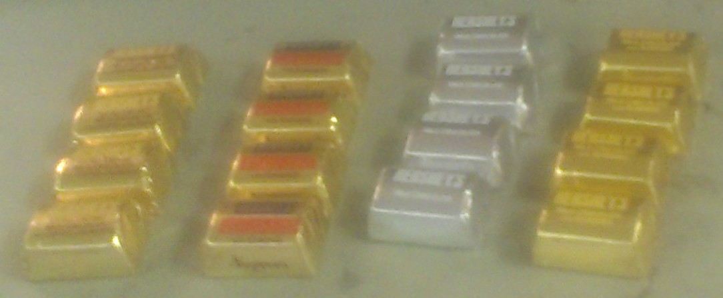
Can you make a multiplication equation with two parts and a whole for these pictures?

Slide 17
Can you make a multiplication equation with two parts and a whole for these pictures?
9 x 1 = 9 or
9 = 3 x 3
3 x 4 = 12 2 x 6 = 12
4 x 3 = 12 12 x 1 = 12
6 x 2 = 12 1 x 12 = 12

Slide 18
Can you make a multiplication equation with two parts and a whole for these pictures?
2 x 7 = 14 7 x 2 = 14 1 x 14 = 14 14= 14x 1
4 x 4 = 16
2 x 8 = 16
8 x 2 = 16
1 x 16 = 16
16 x 1 = 16

Slide 19
Adding or multiplying? You decide
Adding or multiplying?
Adding or multiplying?
… could one of these be both???? Why? And why does the rule “ in the addition game, it’s same to same” still work here? What are you
adding?

